Slide 1
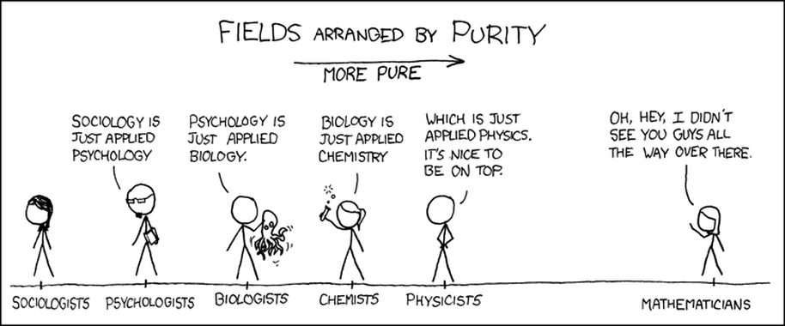
Numbers: What are they good for?
http://blog.forwardmapworks.com/

Slide 2
What are the main strengths of quantitative research/statistics?
http://blog.forwardmapworks.com/

Slide 3
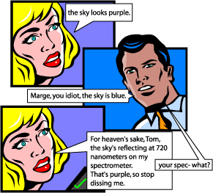
Arguments for quantification
Objectivity
Notes:
Why use quantitative data?

Slide 4
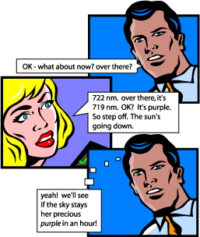
Arguments for quantification
Objectivity
Replication
Notes:
Why use quantitative data?
it allows us to repeat experiments in different times or different places
to discover patterns, regularities, trends…

Slide 5
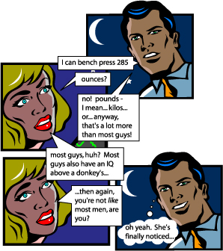
Arguments for quantification
Objectivity
Replication
Comparison
Notes:
Why use quantitative data?
It allows us to compare across places and times.

Slide 6
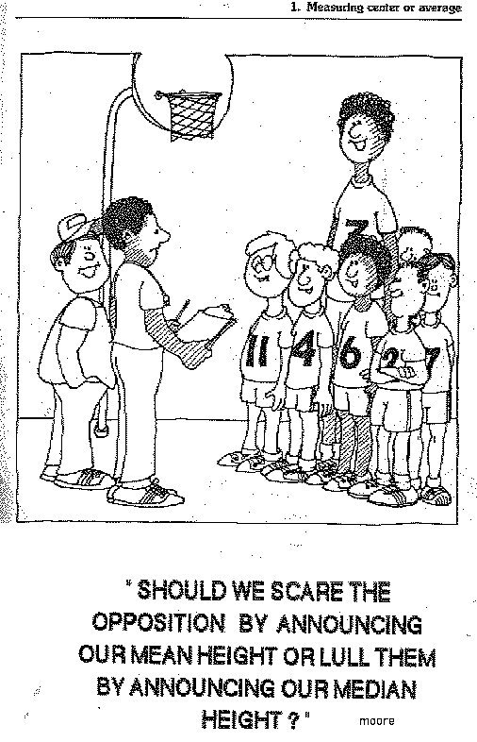
Arguments for quantification
Objectivity
Replication
Comparison
Aggregation
Notes:
It provides systematic ways to deal with outliers and see larger tendencies within the data.
Ex.—in the mid-80s, the average salary of a geography grad from UNC was something like $250,000. Why?

Slide 7
Weaknesses of quantitative methods
Illusion of objectivity?
Abstraction from everyday experience
Necessity of calculable categories (e.g., racial classification)
Notes:
It provides systematic ways to deal with outliers and see larger tendencies within the data.
Ex.—in the mid-80s, the average salary of a geography grad from UNC was something like $250,000. Why?

Slide 8
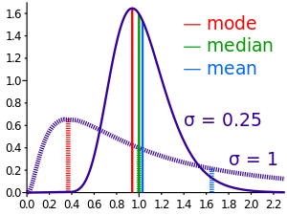
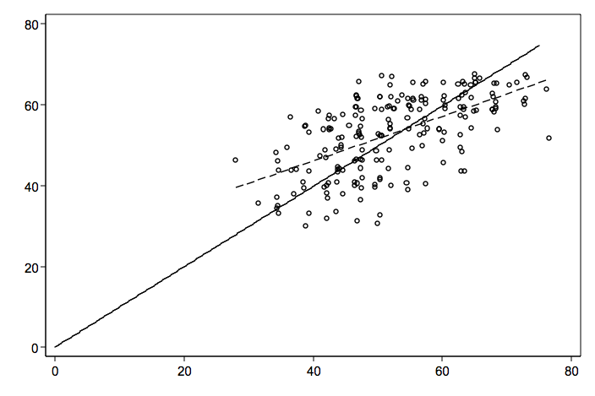
Types of statistics
Descriptive statistics: describes a data set.
Inferential statistics: makes generalizations from a sample group
Notes:
Difference between descriptive and inferential statistics.
Example: rates of cancer in all state counties.

Slide 9
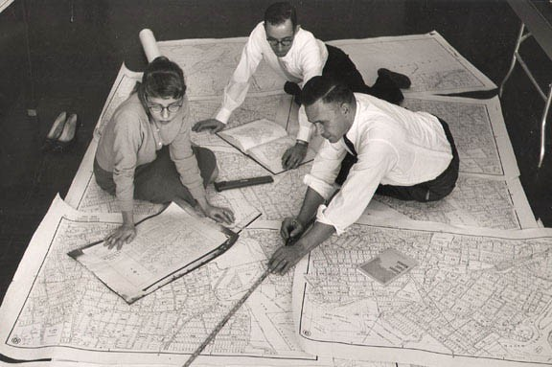
Statistics in Geography
http://blog.forwardmapworks.com/

Slide 10
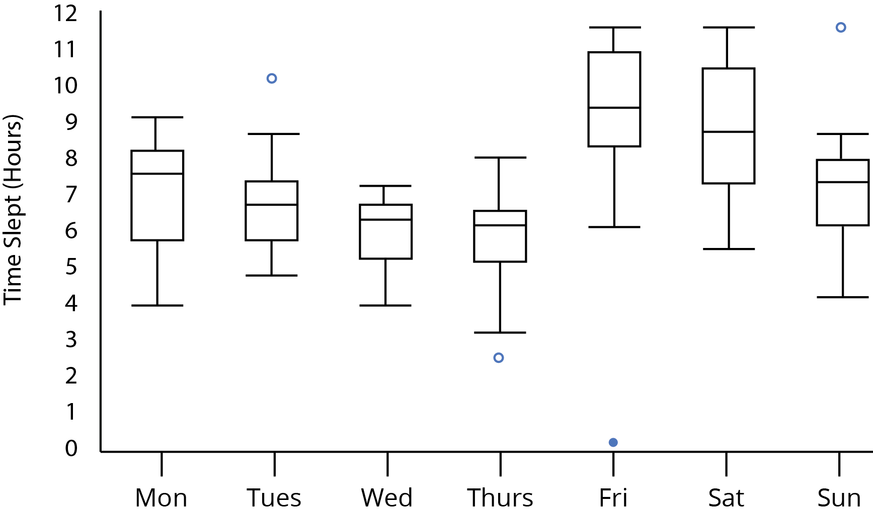
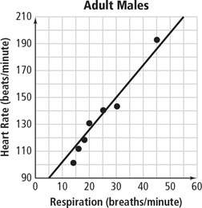
Stats in Geography:
Often similar to other disciplines
Notes:
Difference between descriptive and inferential statistics.
Example: rates of cancer in all state counties.

Slide 11
What’s distinctive about statistics in geography?
Notes:
Difference between descriptive and inferential statistics.
Example: rates of cancer in all state counties.

Slide 12
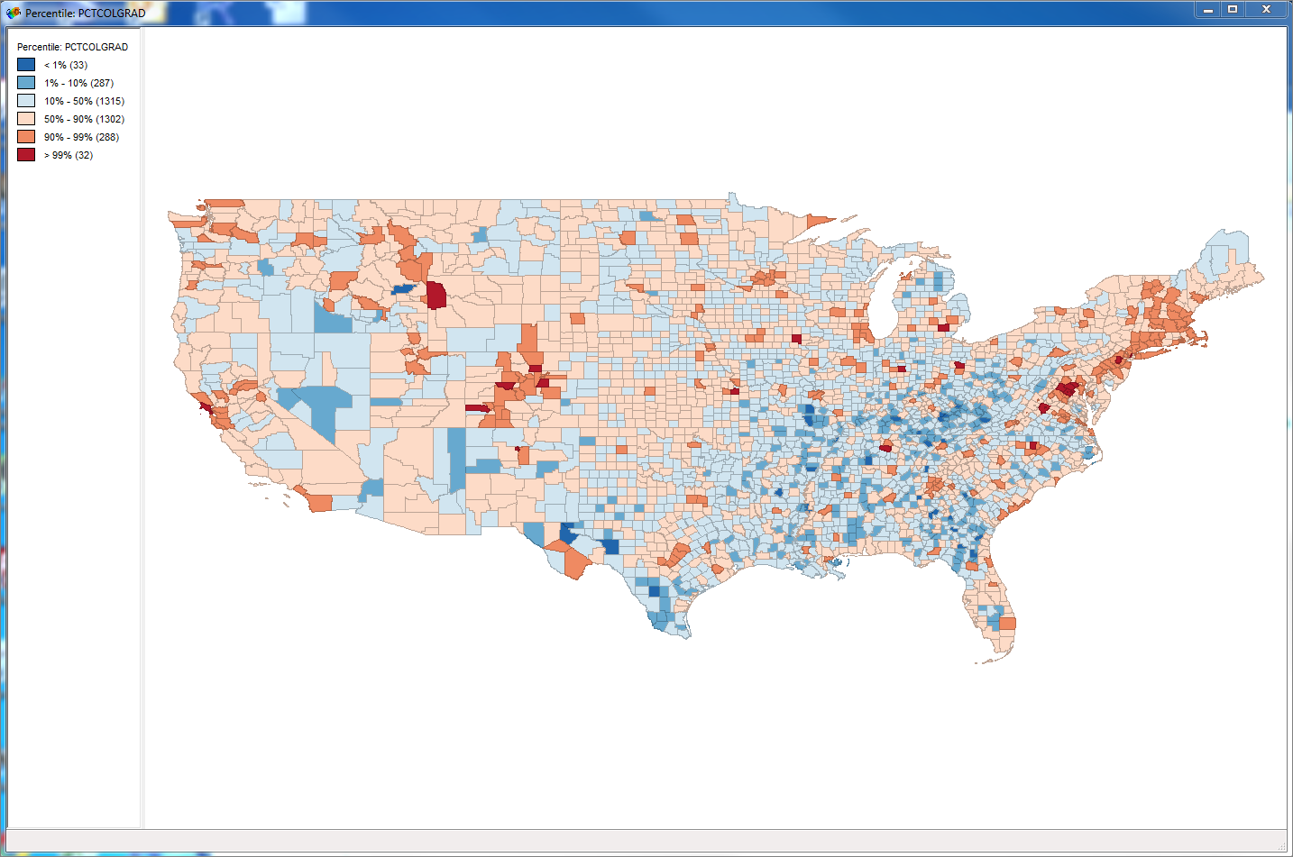
1. Methods
Spatial clustering
Spatial lag/influence
Space/time geography
Notes:
Difference between descriptive and inferential statistics.
Example: rates of cancer in all state counties.

Slide 13
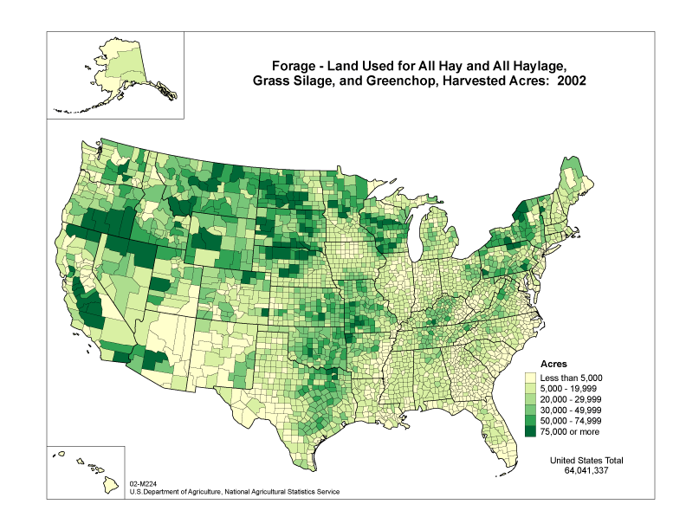
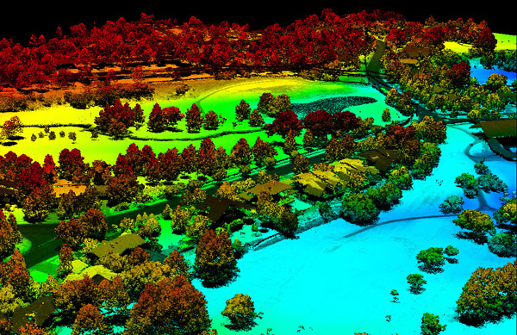
2. Sources of our data
3dgolfcourse.com
Notes:
What makes data geographic?
Wide variety of data sources and methods
Raster and vector based data sources
Information about a place in some form—often now through GIS based techniques

Slide 14


3. Unique disciplinary history

Slide 15
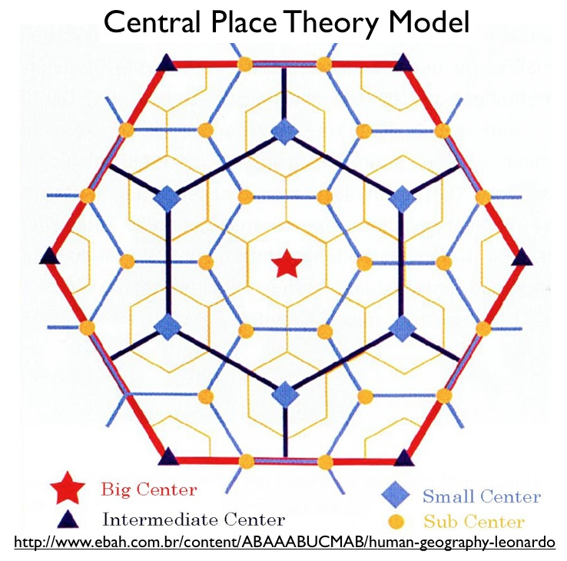
The quantitative revolution
Geocurrents.info
Notes:
Prior to the 1950s, geography was largely a descriptive science: cataloguing the attributes of particular places
Quantitative revolution started in response to widespread criticism of the discipline, closing of the Harvard Dept. in 1948
Move to find regular laws that governed spatial behavior
CENTRAL PLACE THEORY is one example or Thunen rings modeling land use
Seeking predictable patterns for how places develop

Slide 16
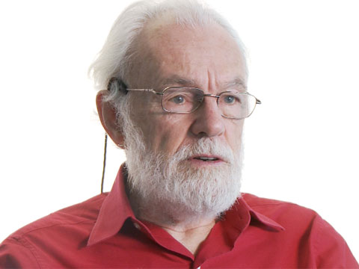

Tensions with critical human geography
http://uscaau.files.wordpress.com
The Guardian
Notes:
Critiques by critical geographers such as David Harvey, saying that these approaches treat as natural laws what are really social processes
Do cities develop this way naturally, or is this just how captialist cities work to produce profit? A need to question supposedly objective approaches for the politics at play.

Slide 17

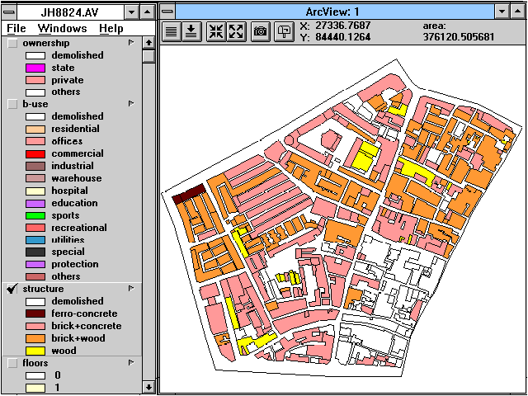
1960s and 1970s:
“Space cadets”
Notes:
Critiques by critical geographers such as David Harvey, saying that these approaches treat as natural laws what are really social processes
Do cities develop this way naturally, or is this just how captialist cities work to produce profit? A need to question supposedly objective approaches for the politics at play.

Slide 18

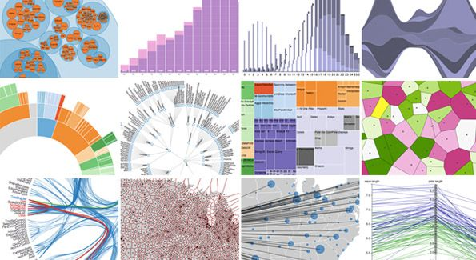
Notes:
More recently, new generation of work on quantitative geography drawing on increased computing power, GIS software, and increasing availability of “big data”
Methods for managing and analyzing datasets of multiple terabytes

Slide 19
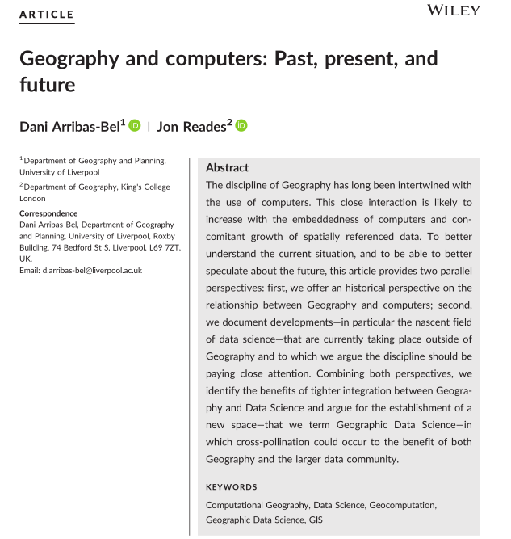
Defining data science
Notes:
Raster data
Comprised of raster cells—all the same size and all with a value
This data is always continuous and there are no discrete units—a single point or area.
Disclaimer: most of my work has been with vector based data
Common raster maps? Temperature data (interpolated), land cover, classified remote sensing imagery
Questions you could ask of a land cover map—what percentage of an area is covered by various land cover types. What’s the relationship between type of land cover and other characteristics: elevation, proximity to certain features, etc.?

Slide 20
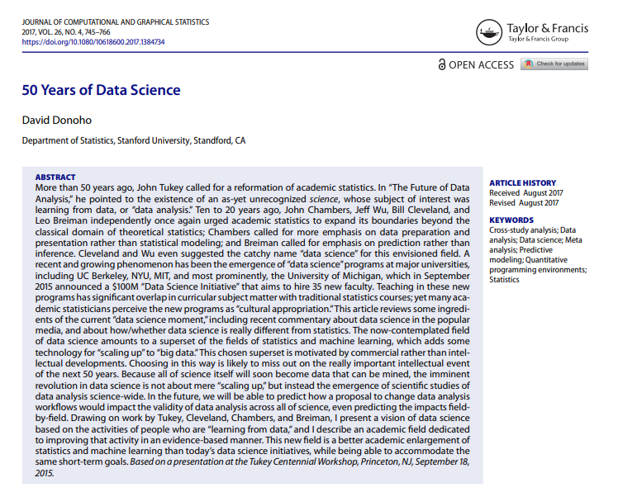
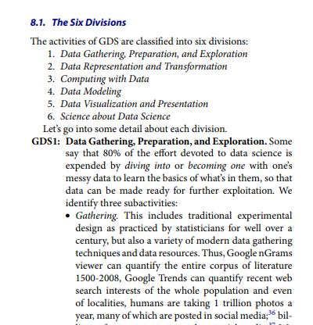
Notes:
Raster data
Comprised of raster cells—all the same size and all with a value
This data is always continuous and there are no discrete units—a single point or area.
Disclaimer: most of my work has been with vector based data
Common raster maps? Temperature data (interpolated), land cover, classified remote sensing imagery
Questions you could ask of a land cover map—what percentage of an area is covered by various land cover types. What’s the relationship between type of land cover and other characteristics: elevation, proximity to certain features, etc.?

Slide 21
For Friday’s check in: Read through this section (posted on ELC). Which have you done before? What’s least familiar?
Notes:
Raster data
Comprised of raster cells—all the same size and all with a value
This data is always continuous and there are no discrete units—a single point or area.
Disclaimer: most of my work has been with vector based data
Common raster maps? Temperature data (interpolated), land cover, classified remote sensing imagery
Questions you could ask of a land cover map—what percentage of an area is covered by various land cover types. What’s the relationship between type of land cover and other characteristics: elevation, proximity to certain features, etc.?

Slide 22
“The recent explosion of data is not only a quantitative change in the amount of digital, machine‐readable information
at the fingertips of researchers and industry, it is also a profoundly qualitative change in how we think about, and work with, data. In this respect, Data Science is an already existing effort to make sense of, and synthesise the most appropriate ways to cope with, this ‘brave new world.’”
Notes:
Raster data
Comprised of raster cells—all the same size and all with a value
This data is always continuous and there are no discrete units—a single point or area.
Disclaimer: most of my work has been with vector based data
Common raster maps? Temperature data (interpolated), land cover, classified remote sensing imagery
Questions you could ask of a land cover map—what percentage of an area is covered by various land cover types. What’s the relationship between type of land cover and other characteristics: elevation, proximity to certain features, etc.?

Slide 23


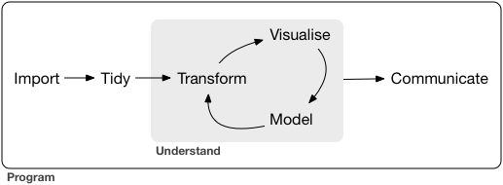
Next time:
Getting started with R and the “tidyverse”
Notes:
Raster data
Comprised of raster cells—all the same size and all with a value
This data is always continuous and there are no discrete units—a single point or area.
Disclaimer: most of my work has been with vector based data
Common raster maps? Temperature data (interpolated), land cover, classified remote sensing imagery
Questions you could ask of a land cover map—what percentage of an area is covered by various land cover types. What’s the relationship between type of land cover and other characteristics: elevation, proximity to certain features, etc.?

